Slide 1
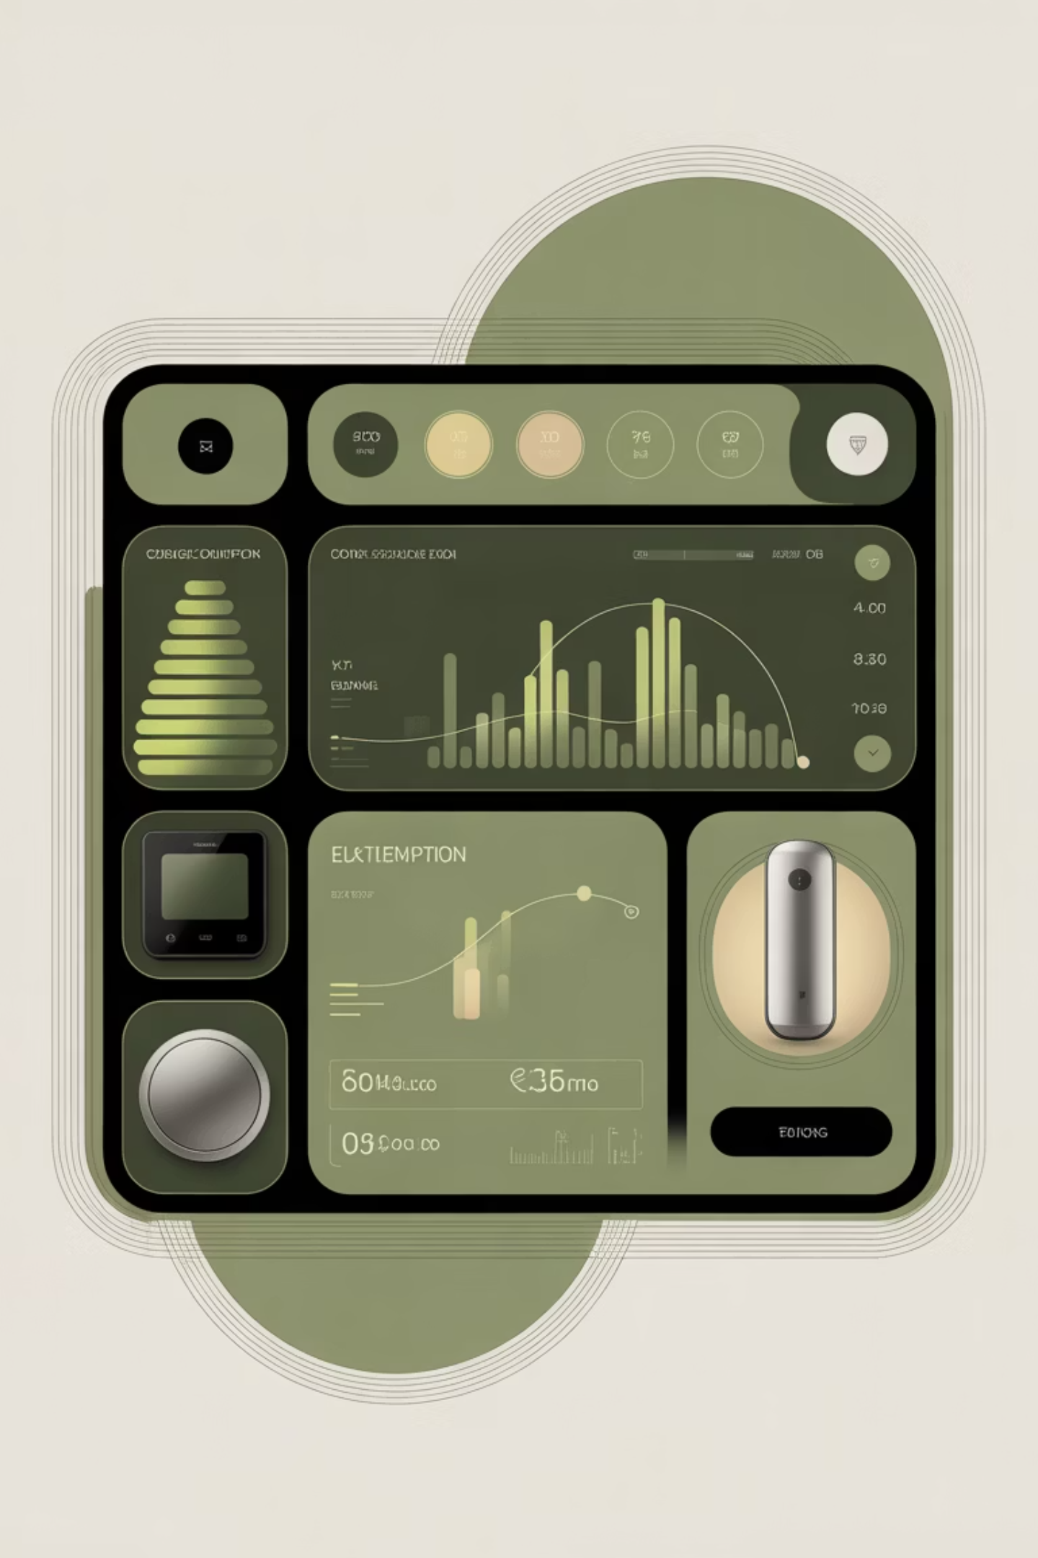
Smart Device Management System
Efficiently Managing Energy in Connected Homes
- By Kazi Jiya Mukim

Slide 2


PROJECT OVERVIEW
Revolutionising Smart Home Energy
This project introduces a comprehensive Smart Device Management System, meticulously designed to integrate and optimise energy consumption within modern smart homes.
The system provides a centralised platform for homeowners to monitor, control, and automate their smart devices, leading to enhanced energy efficiency, reduced utility costs, and a more comfortable living environment.

Slide 3

MODULE DEFINITION
Understanding the Core Module
Meaning of the Module
The Smart Device Management module serves as the central brain of our energy management system. It's responsible for the seamless discovery, registration, and ongoing management of all smart devices within the home network.
Activities Performed by the Module
Device Discovery & Pairing: Automatically identifies and connects new smart devices.
Real-time Monitoring: Tracks energy usage and operational status of all connected devices.
Remote Control: Allows users to operate devices from anywhere.
Scheduling & Automation: Enables predefined actions and rule-based automation for energy savings.
Reporting & Analytics: Generates insights into energy consumption patterns.

Slide 4
SYSTEM ARCHITECTURE CLASSES
Key Components of Device Management
1
2
Device (The Entity/Model)
Device Controller
Represents the data structure for a smart device, including properties like ID, name, type, status, and energy consumption metrics.
Handles incoming API requests, orchestrating interactions between the user interface and the business logic layer.
3
4
Device Service (The Business Logic)
Device Repository (The Data Layer)
Encapsulates the core functionalities related to device management, such as adding, updating, deleting, and querying devices.
Manages data persistence, interacting with the database to store and retrieve device information.

Slide 5
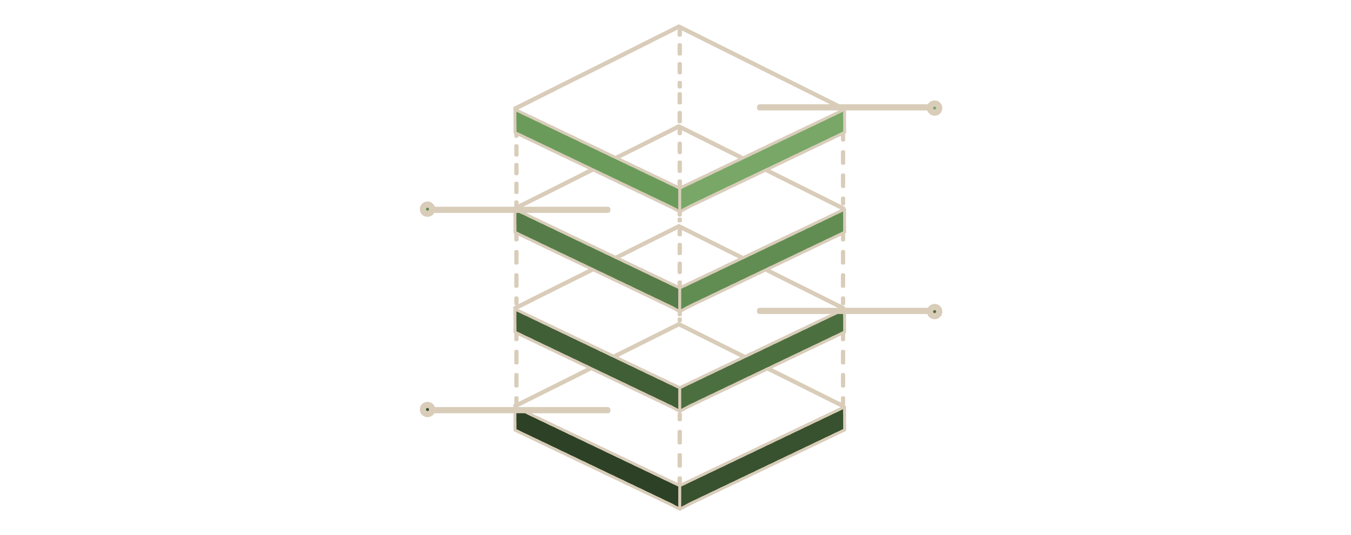
AUTHENTICATION MODULE CLASS DIAGRAM
Securing Your Smart Home
SessionStore
Persists active session metadata
TokenManager
Issues and revokes access tokens
AuthenticationService
Validates credentials and sessions
User
Represents system account and credentials

Slide 6
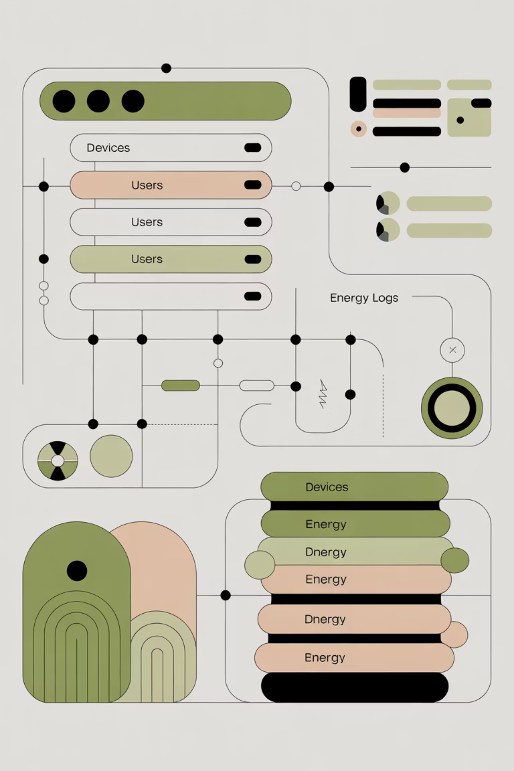
DATABASE SCHEMA FOR MODULE 1
Structured Data for Device Information
This database schema outlines the foundational structure for storing all relevant data within Module 1. It details tables such as Devices (device_id, name, type, status, energy_consumption), Users (user_id, username, password_hash), and EnergyLogs (log_id, device_id, timestamp, usage_value), along with their respective relationships and constraints.

Slide 7
PSEUDOCODE FOR MODULE 1
Logic Flow for Device Management
FUNCTION addDevice(deviceData):
VALIDATE deviceData
IF deviceData is valid:
CREATE new Device object from deviceData
SAVE Device object to DeviceRepository
RETURN success confirmation
ELSE:
RETURN error message
FUNCTION getDeviceById(deviceId):
FETCH Device from DeviceRepository by deviceId
IF Device found:
RETURN Device object
ELSE:
RETURN null
FUNCTION updateDeviceStatus(deviceId, newStatus):
FETCH Device from DeviceRepository by deviceId
IF Device found:
UPDATE Device.status to newStatus
SAVE updated Device to DeviceRepository
RETURN success confirmation
ELSE:
RETURN error message
This pseudocode outlines the core functions within Module 1, demonstrating the logical steps for adding, retrieving, and updating smart device information.

Slide 8
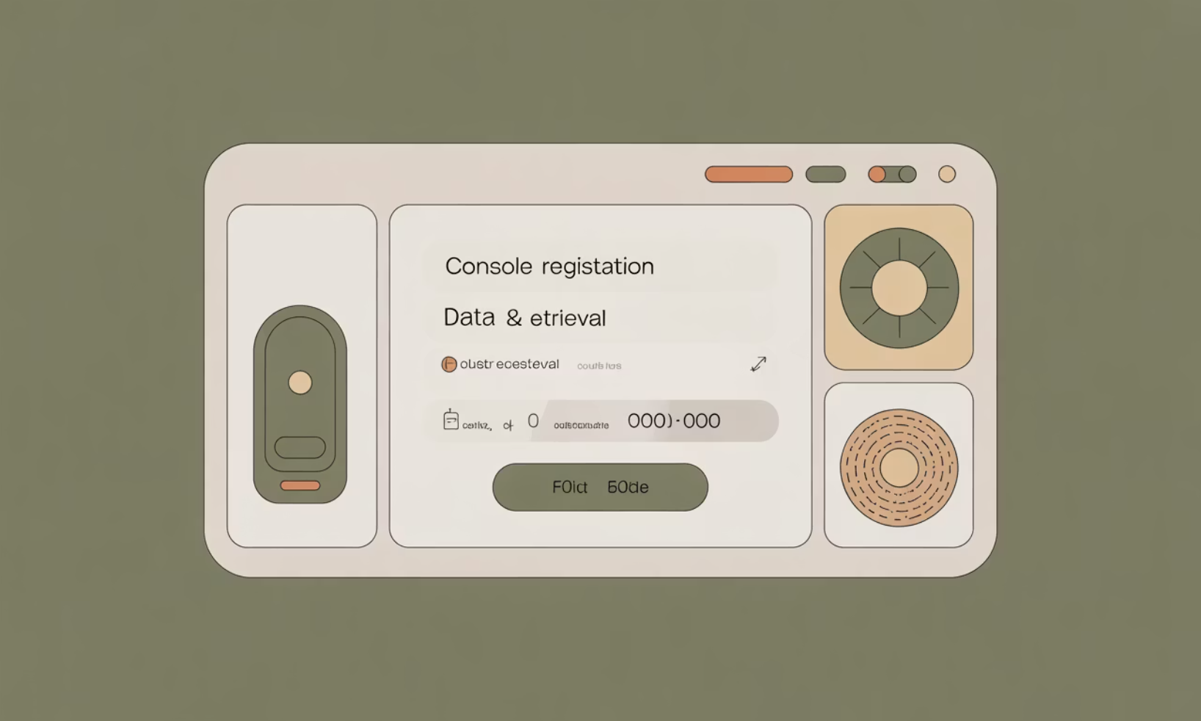
JAVA IMPLEMENTATION & RESULTS
Bringing Code to Life
Expected Output & Benefits
Upon successful execution, the Java implementation provides a robust API for managing smart devices.
Sample Java Code Snippet
Seamless integration with existing smart home platforms.
Real-time updates on device status and energy consumption.
Reduced manual intervention through automation.
Improved user experience with a responsive and intuitive system.
public class DeviceService {
@Autowired
private DeviceRepository deviceRepository;
public Device addDevice(Device device) {
// Basic validation
if (device.getName() == null || device.getName().isEmpty()) {
throw new IllegalArgumentException("Device name cannot be empty");
}
return deviceRepository.save(device);
}
public Optional<Device> getDevice(String id) {
return deviceRepository.findById(id);
}
}

Slide 9

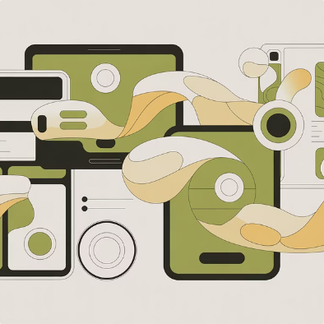
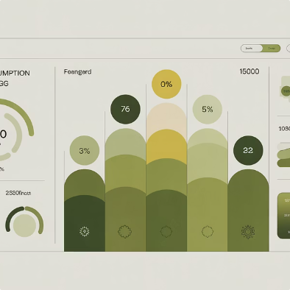
FUTURE ENHANCEMENTS
Next Steps for Evolution
AI-Powered Optimisation
Expanded Device Compatibility
Advanced Reporting & Visualisation
Integrate machine learning algorithms to predict energy consumption and proactively optimise device schedules for maximum savings.
Broaden support for a wider range of smart home ecosystems and proprietary device protocols.
Develop more sophisticated dashboards and analytical tools for deeper insights into energy usage patterns.

Slide 10

Thank You!

